Slide 1

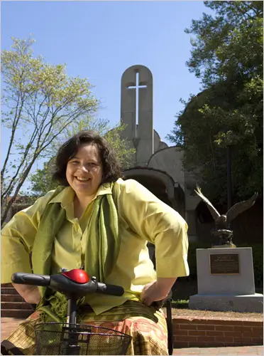
Notes:
Photo Source: Douglas Martin, “Nancy Eiesland Is Dead at 44; Wrote of a Disabled God,” New York Times online, last updated March 21, 2009, https://www.nytimes.com/2009/03/22/us/22eiesland.html.
Image Description of Book Cover: Red cover with a colorful collage. White title: The Disabled God: Toward a Liberatory Theology of Disability.
Image Description of Nancy Eiesland: White woman with short brown hair, wearing a yellow shirt and green scarf, smiling on a mobility scooter in front of a stone church.

Slide 2

Janey Carter
“I saw God in a sip-puff wheelchair, that is, the chair used mostly by quadriplegics enabling them to maneuver by blowing and sucking on a strawlike device. Not an omnipotent, self-sufficient God, but neither a pitiable, suffering servant. In this moment, I beheld God as a survivor, unpitying and forthright. I recognized the incarnate Christ in the image of those judged ‘not feasible,’ ‘unemployable,’ with ‘questionable quality of life.’ Here was God for me.”
Eiesland, The Disabled God, 89.
Notes:
Photo Source: https://www.tiktok.com/@janeycarter_/video/6934370797297437958
Image Description: Janey Carter, a white woman with brown hair in a ponytail, sits in a power wheelchair at a desk in a bright home interior. She wears a light blue T-shirt and denim shorts. A strawl-ike assistive device is mounted near her head and positioned at her lips. In front of her is an open laptop on a white table, along with a green potted plant. The room has light gray walls, wooden floors, and mirrors mounted on the walls.

Slide 3
Isaiah 53:2-3
“…he had no form or majesty that we should look at him, nothing in his appearance that we should desire him. He was despised and rejected by others; a man of suffering and acquainted with infirmity, and as one from whom others hide their faces he was despised, and we held him of no account.”

